Slide 1


Social Buzz

Slide 2


Today's agenda
Project Recap
To give a clear idea of the business problem we’re solving and the exact needs, we'll give a brief summary.
Problem
We will focus on the specific problem the Data Analytics team has been working on and explain why this problem is so important.
The Analytics Team
I will first explain the problem and then talk about the team responsible for managing this task on our side.
Process
After that, I’ll explain the main steps we took to complete this task, so you can see how we handle similar tasks.
Insights & Summary
Lastly, I will go over all the key findings and present them as a collection of insights and examples from our work.

Slide 3

“Social Buzz” has reached over 500 million active users each month.
They have scaled quicker than anticipated and need the help of an
advisory firm to over see their scaling process effectively.
Accenture has started working on the following activities during
A three-month POC:
* An audit of their big data practice.
* Recommendations for a successful IPO.
* An analysis of their content categories that highlights the top 5
Categories with the largest aggregate popularity.
Project Recap

Slide 4

Problem
Over 10,000 posts per day 36,500,000 pieces of content per year!
But how to capitalize it when there is maximum?
Analysis to find Social Buzz’s top 5 most popular categories of content

Slide 5



The Analytics team

Slide 6
Process
1
Understanding Data
2
Data Cleaning
3
Data Modelling
4
Data Analysis
5
Data Insights

Slide 7

Insights
16
1897
MAY
Unique Categories
Animal most favorite category with max reactions
Month is most number of posts

Slide 8
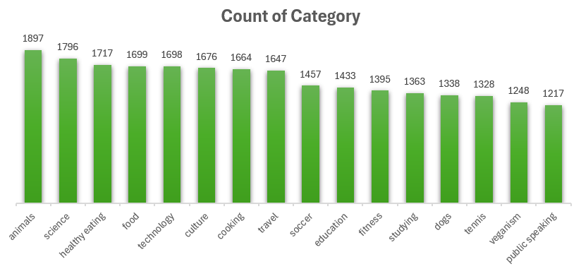

Slide 9
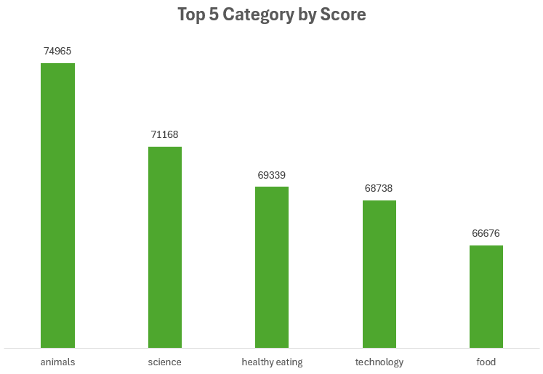

Slide 10
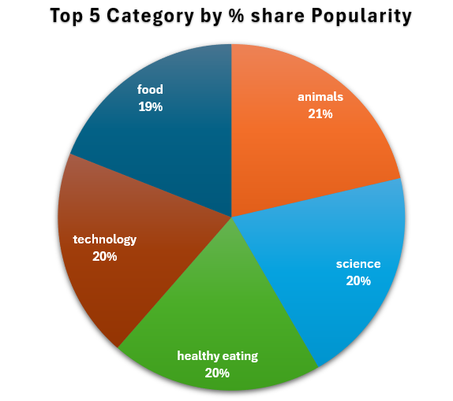

Slide 11
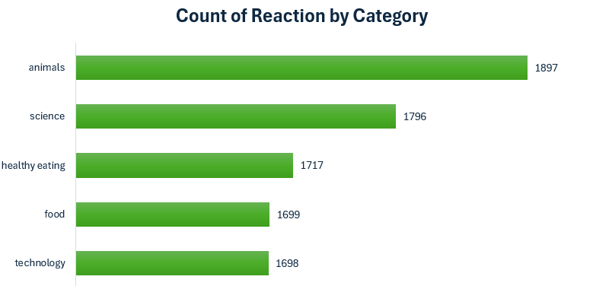

Slide 12
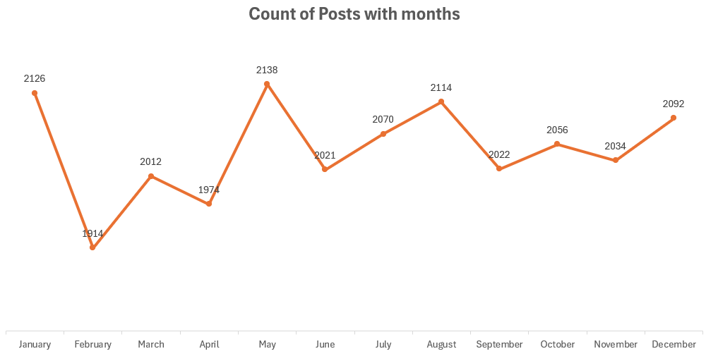

Slide 13
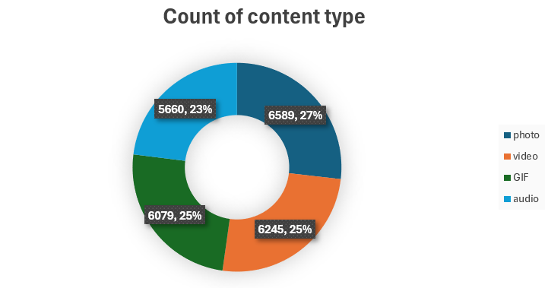

Slide 14
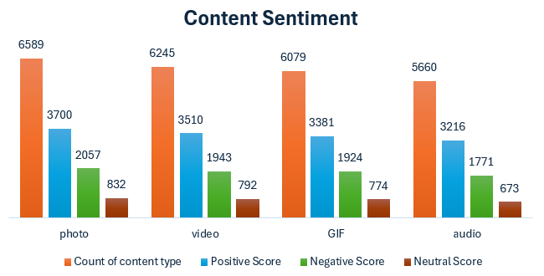

Slide 15

There are 16 unique content categories.
Out of which Animal and Science categories
Are most popular.
There are 4 type of contents-Photo,Video,GIF,Audio.
Out of which people prefer Photo and Video.
May month has the higher number of posts.
Summary
Conclusion
Should focus more on top 5 categories that’s animal, technology,science,health eating and food.
Create campaign to specially target on those audience.
Need to maximize in the month of Jan, May and Aug as they no. of posts in these months are highest.

Slide 16
Thank you!
ANY QUESTIONS?

